Slide 1
Combined Scheduling Model
Telfer School of Management, University of Ottawa
Model Formulation (Policy Comparison)
August 10, 2020
Notes:
TEŞEKKÜR

Slide 2
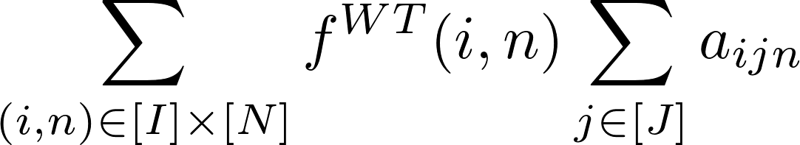

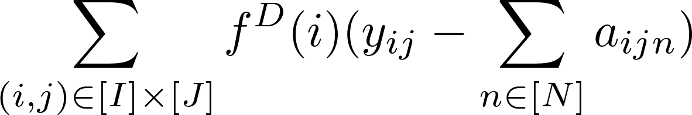
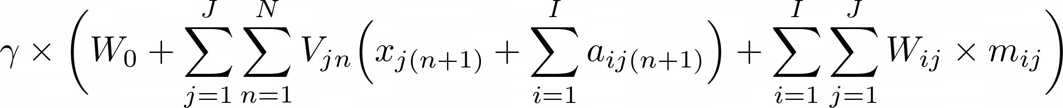
Combined Scheduling
MIP Model - Policy Comparison Problem
Min
+
> penalty cost associated with booking patients beyond the priority-specific wait time targets
+
> cost associated with the day of service (wait time, overtime and/or idle time).
+
> penalty cost associated with delaying the booking decision for some of the waiting demand
> expected discounted cost to go
Subject to
Several constraints presented in the next slides

Slide 3
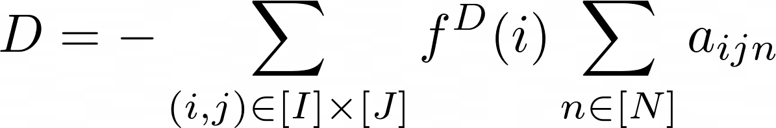
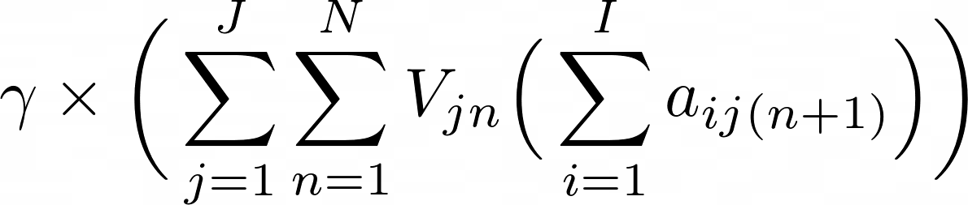
Combined Scheduling
MIP Model - Policy Comparison Problem - Simplified
Min
+
> penalty cost associated with booking patients beyond the priority-specific wait time targets
+
> cost associated with the day of service (wait time, overtime and/or idle time).
+
> penalty cost associated with delaying the booking decision for some of the waiting demand
> expected discounted cost to go
Subject to
Several constraints presented in the next slides

Slide 4
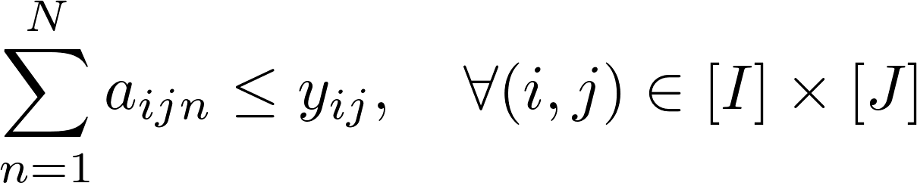
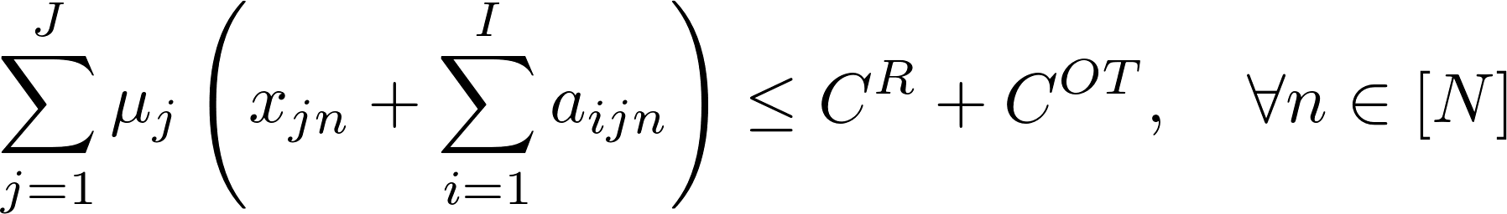
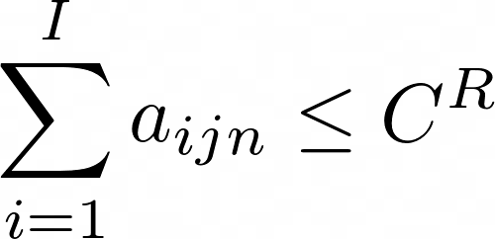
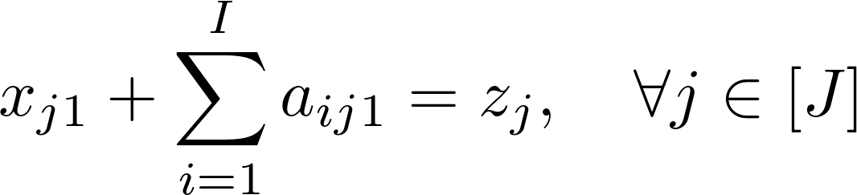
Combined Scheduling
MIP Model - Policy Comparison Problem
The number of bookings cannot exceed the number of patients waiting
Overtime capacity cannot be exceeded.
Number of slots booked for tomorrow for each service class

Slide 5
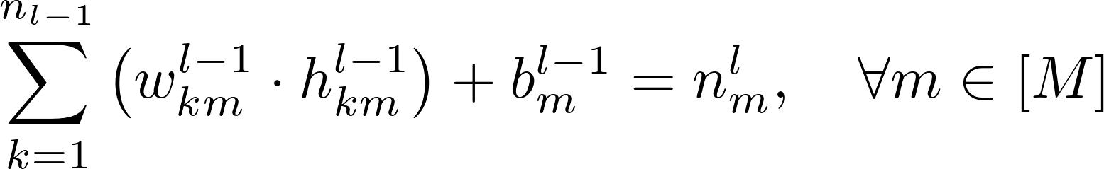
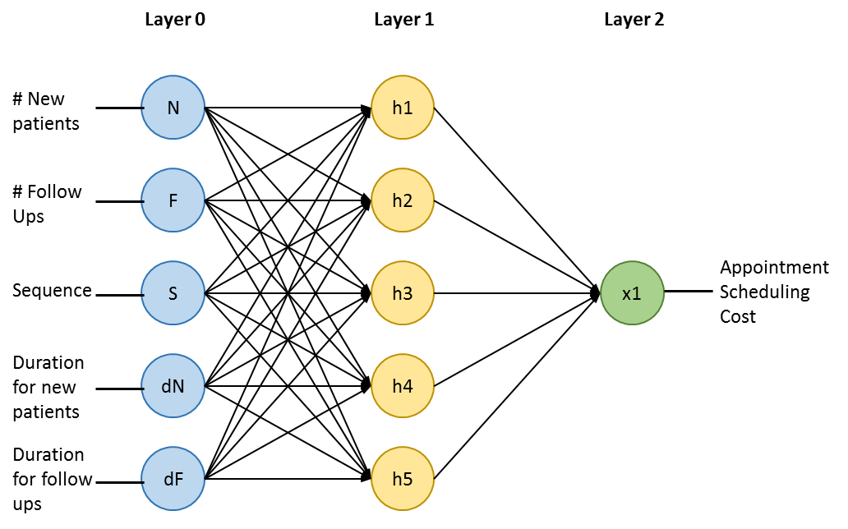
Mathematical model
MIP Model - Policy Comparison Problem
Neuron values are sum product of weights and inputs plus bias. Note that first layer inputs are (#N, # F, Sequence, dN, dF)
Activation constraints. h = max(0, n)
X2[0]
X2[1]

